Slide 1
BASKETBALL DATA ANAlytics
Shirley wang & howard jiang

Slide 2
Data source
http://webhome.cs.uvic.ca/~thomo/basketballman.db

Slide 3
schema
abbrev{
abbre_type VARCHAR(20),
code VARCHAR(10),
full_name VARCHAR(30),
};
award_coaches{
year INT,
coachID VARCHAR(20),
award VARCHAR(30),
lgID VARCHAR(10),
note VARCHAR(10),
};
award_players{
playerID VARCHAR(30),
award VARCHAR(50),
year INT,
lgID VARCHAR(10),
note VARCHAR(10),
pos VARCHAR(10),
}; coaches{
coachID VARCHAR(30),
year INT tmID VARCHAR(10),
lgID VARCHAR(10),
stint INT,
won INT,
lost INT,
post_wins INT,
post_losses INT
};
draft{
draftYear INT,
draftRound INT, draftSelection INT, draftOverall INT tmID VARCHAR(30), firstName VARCHAR(30),
lastName VARCHAR(30), suffixName VARCHAR(30),
playerID VARCHAR(30), draftFrom VARCHAR(50),
lgID VARCHAR(30)
};
hof{ year INT,
hofID VARCHAR(30), name VARCHAR(30), category VARCHAR(30), };

Slide 4
Schema
master{ bioID VARCHAR(30), useFirst VARCHAR(30), firstName VARCHAR(30), lastName VARCHAR(30), nameGiven VARCHAR(60), fullGivenName VARCHAR(30), nameSuffix VARCHAR(30), nameNick VARCHAR(30),
pos VARCHAR(30),
firstseason INT,
lastseason INT,
height FLOAT,
weight INT, college VARCHAR(30),
collegeOther VARCHAR(60), birthDate VARCHAR(30), birthCity VARCHAR(30), birthState VARCHAR(30), birthCountry VARCHAR(30), highSchool VARCHAR(70), hsCity VARCHAR(60), hsState VARCHAR(30),
hsCountry VARCHAR(30), deathDate VARCHAR(30),
race VARCHAR(30),
};
player_allstar{
player_id VARCHAR(30), last_name VARCHAR(30), first_name VARCHAR(30), season_id INT, conference VARCHAR(30), league_id VARCHAR(30), games_played INT, minutes INT, points INT, o_rebounds INT, d_rebounds INT, rebounds INT, assists INT, steals INT, blocks INT, turnovers INT, personal_fouls INT, fg_attempted INT, fg_made INT, ft_attempted INT, ft_made INT, three_attempted INT, three_made INT,
};
series_post{
year INT, round VARCHAR(30), series VARCHAR(30), tmIDWinner VARCHAR(30), lgIDWinner VARCHAR(30), tmIDLoser VARCHAR(30), lgIDLoser VARCHAR(30),
W INT, L INT,
};
players{
playerID VARCHAR(30), year INT, stint INT, tmID VARCHAR(30), lgID VARCHAR(30), GP INT, GS INT, minutes INT, points INT, oRebounds INT, dRebounds INT, rebounds INT, assists INT, steals INT, blocks INT, turnovers INT, PF INT, fgAttempted INT, fgMade INT, ftAttempted INT, ftMade INT, threeAttempted INT, threeMade INT, PostGP INT, PostGS INT, PostMinutes INT, pointPoints INT, PostoRebounds INT, PostdRebounds INT, PostRebounds INT, PostAssists INT, PostSteals INT, PostBlocks INT, PostTurnovers INT,
PostPF INT,
PostfgAttempted INT, PostfgMade INT, PostftAttempted INT, PostftMade INT, PostthreeAttempted INT, PostthreeMade INT, note VARCHAR(30),
};

Slide 5
schema
teams{
year INT,
lgID VARCHAR(30),
tmID VARCHAR(30), franchID VARCHAR(30), confID VARCHAR(30),
divID VARCHAR(30),
rank INT,
confRank INT,
playoff VARCHAR(30),
name VARCHAR(30),
o_fgm INT,
o_fga INT,
o_ftm INT,
o_fta INT,
o_3pm INT,
o_3pa INT,
o_oreb INT,
o_dreb INT,
o_reb INT,
o_asts INT,
o_pf INT,
o_stl INT,
o_to INT,
o_blk INT,
o_pts INT,
d_fgm INT,
d_fga INT,
d_ftm INT,
d_fta INT,
d_3pm INT,
d_3pa INT,
d_oreb INT,
d_dreb INT,
d_reb INT,
d_asts INT,
d_pf INT,
d_stl INT,
d_to INT,
d_blk INT,
d_pts INT,
o_tmRebound INT, d_tmRebound INT,
homeWon INT,
homeLost INT,
awayWon INT,
awayLost INT,
neutwon INT,
neutloss INT,
confWon INT,
confLoss INT,
divWon INT,
divLoss INT,
pace INT,
won INT,
lost INT,
games INT,
min INT,
arena VARCHAR(30),
attendance INT,
bbtmLID VARCHAR(30),
};

Slide 6
challenges
Due to The large amount of data, We needed a lot of time to analyze the data
We Needed to figure out how to use sql language to filter useful information
According to the information we filtered, we had to draw an interesting conclusion

Slide 7
Q1: Find the AMERICAN STATE WITH MOST PLAYERS WITH AWARDS
SELECT BIRTHSTATE, count(PLAYERID) AS numPlayers
FROM BASKETBALL_AWARDS_PLAYERS PA JOIN BASKETBALL_MASTER M ON PA.PLAYERID = M.BIOID
WHERE M.BIRTHCOUNTRY = 'USA'
GROUP BY M.BIRTHSTATE
ORDER BY count(PLAYERID) DESC;

Slide 8
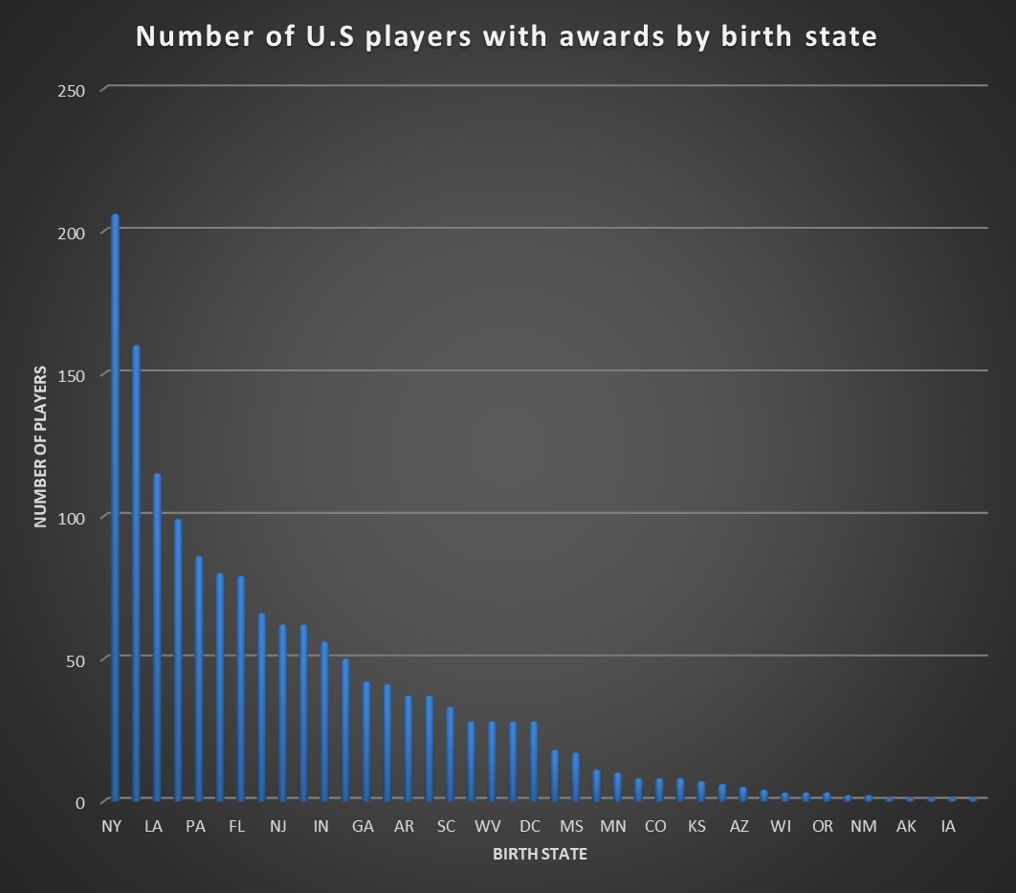

Slide 9
Q1: Conclusions
Most American players (about 206 players) who won awards were drafted from New York (NY).
The states of Iowa (ia) and Wyoming (WY) each only had one player with awards drafted from there.
The large difference between states is likely due to the discrepancy in total number of players drafted from each state. It may also be because new york players are more skilled and thus more likely to be awarded, or because new york players are more favoured

Slide 10
Q2: FIND THE TOP I5 TEAMS WINS OR LOSSES
SELECT *
FROM
(SELECT name, SUM(HOMEWON) AS homewins, SUM(HOMELOST) AS homelosses, SUM(AWAYWON) AS awaywins, SUM(AWAYLOST) AS awaylosses
FROM BASKETBALL_TEAMS
GROUP BY name
ORDER BY SUM(HOMEWON) DESC)
WHERE rownum <= 15

Slide 11
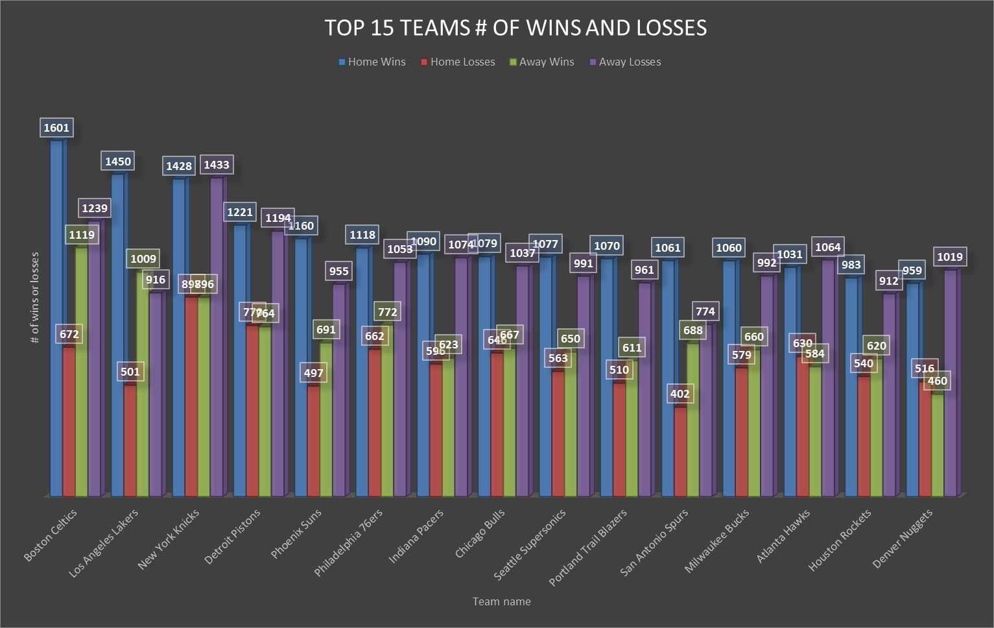

Slide 12
Q2: Conclusions
The Boston Celtics had the largest total number of home wins at 1601 home wins.
The 2nd team, Los Angeles Lakers, is the only team on the top 15 that has more away wins than away loses.
All teams have more home wins than home loses

Slide 13
Q3: TOTAL NUMBER OF PLAYERS’ POINTS of ABA teams and NBA teams
SELECT "year", LGID, SUM(POINTS) as totalPoints
FROM BASKETBALL_PLAYERS
WHERE "year" >=1967 AND "year" <1976
GROUP BY LGID, "year"
ORDER BY "year";

Slide 14
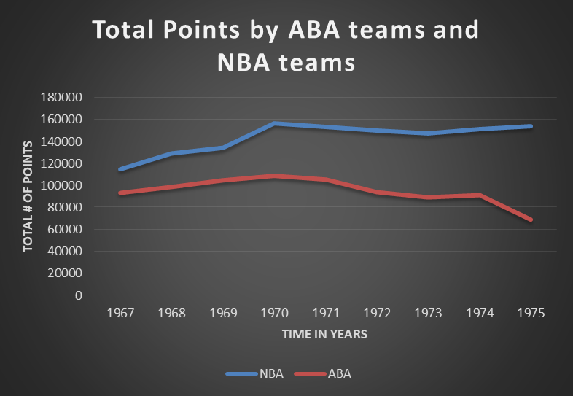

Slide 15
Q3: conclusions
The American basketball association (ABA) was founded in 1967 and merged with the National Basketball Association (NBA) in 1976
Comparing the total number of player points from the ABA and the NBA, we see that the NBA always had more points than the ABA and the difference only increased with time
This may explain why the ABA eventually merged into the NBA

Slide 16
Q4: Top 10 places most players drafted from
SELECT *
FROM
(SELECT DRAFTFROM, COUNT(DISTINCT (firstname || ' '|| lastname)) AS numPlayers
FROM BASKETBALL_DRAFT
GROUP BY DRAFTFROM
ORDER BY numPlayers DESC)
WHERE rownum <= 10;

Slide 17
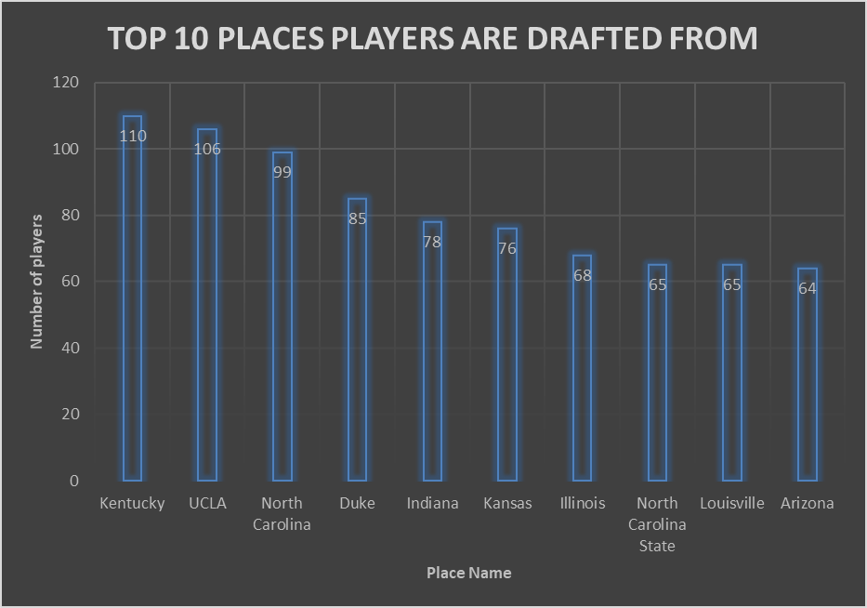

Slide 18
Q4: conclusions
Most players are drafted from Kentucky (110 players), although it’s very closely followed by UCLA (106 players)
Universities are common places to draft players from, as UCLA and Duke are both in the top 10

Slide 19
Q5: Top coach with most wins minus loses
SELECT "year", MAX(won-lost) AS winMinusLose
FROM BASKETBALL_COACHES
WHERE "year" <=2010 AND "year" >=2000
GROUP BY "year"
ORDER BY "year";

Slide 20
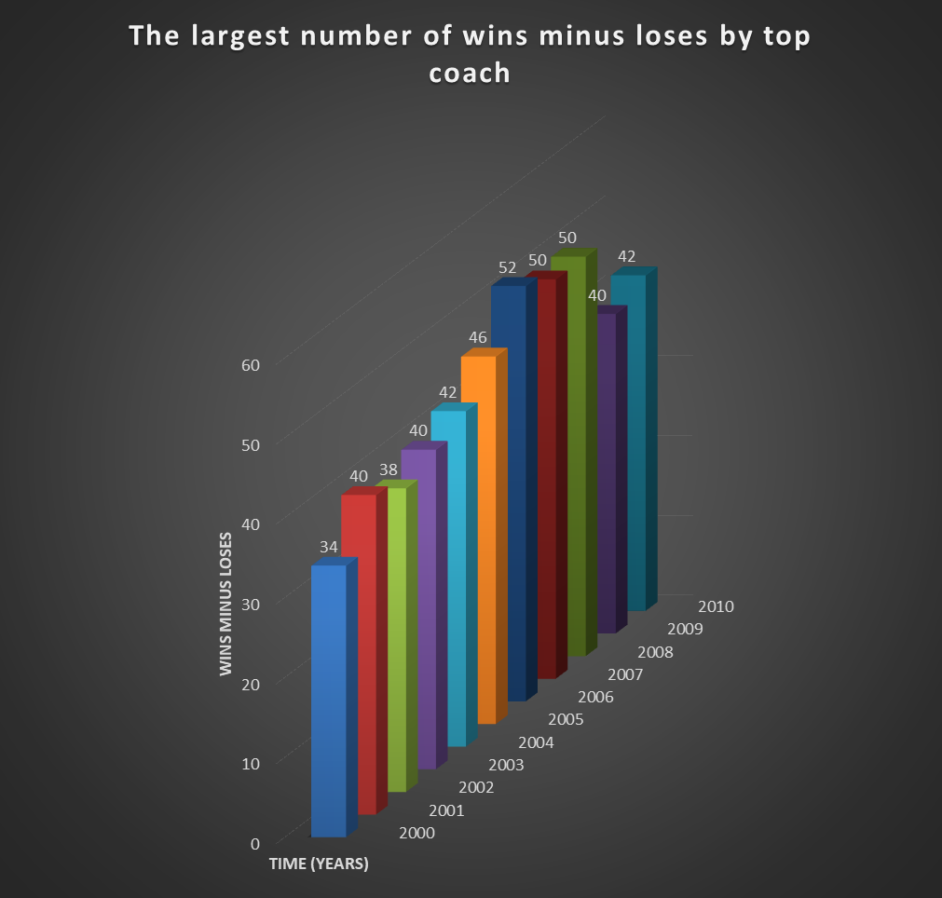

Slide 21
Q5: conclusions
The top coach of the year was defined by the coach with the most number of wins minus loses
From 2000 onwards, the most wins minus loses of the top coach steadily increased until it reached the peak at 52 wins-loses in 2006. it then decreased slightly in 2009 and 2010

Slide 22
Q6: # of awarded coaches and players in the HOF for an opposite category
SELECT *
FROM
(SELECT name, COUNT(*) AS numHOFPAwardC
FROM BASKETBALL_HOF H JOIN BASKETBALL_AWARDS_PLAYERS P ON H.hofID=P.playerID
WHERE CATEGORY='Coach'
GROUP BY name
ORDER BY numHOFPAwardC DESC)
NATURAL FULL OUTER JOIN
(SELECT name, COUNT(*) AS numHOFCAwardP
FROM BASKETBALL_HOF H JOIN BASKETBALL_AWARDS_COACHES C ON H.hofID=C.coachID
WHERE CATEGORY='Player'
GROUP BY name);

Slide 23
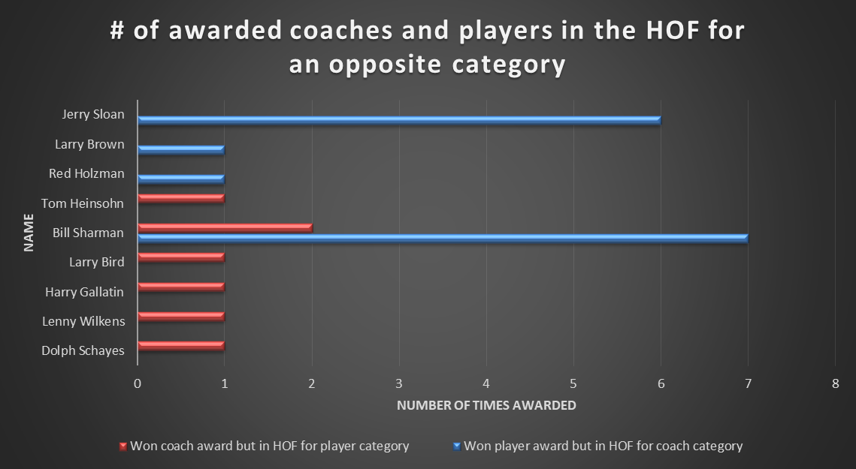

Slide 24
Q6: conclusions
It’s not very common for a person who won a player award to also be honored in the Hall of Fame in the coach category and vice versa.
However, there are examples of 9 people in history whom this occurred to
bill Sharman stands out as the person who has been honored for being both an exemplary player and an exemplary coach

Slide 25
Q7: Number of times teams were ranked 1 in the Eastern Division, at least twice
SELECT name, COUNT(name) AS numRank1inED
FROM BASKETBALL_TEAMS T JOIN BASKETBALL_ABBREV A ON T.DIVID=A.CODE
WHERE "rank"=1 AND full_name = 'Eastern Division'
GROUP BY NAME
HAVING COUNT(name)>1
ORDER BY numRank1inED DESC;

Slide 26
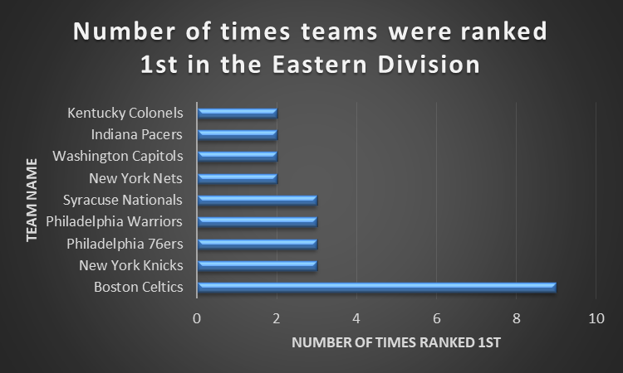

Slide 27
Q7: conclusions
Throughout history, The Boston Celtics have been ranked 1st in the Eastern Division the largest number of times (9 times).
This is triple the score of the 2nd top team, the New York Knicks, who were ranked 1st only 3 times

Slide 28
Q8: number of times players with >4 steals were part of a team that won the finals
SELECT fullname, COUNT(*) AS numTimesWonFinals
FROM
(SELECT DISTINCT (first_name || ' '|| last_name) AS fullname, tmid
FROM BASKETBALL_PLAYER_ALLSTAR A JOIN BASKETBALL_PLAYERS P ON A.PLAYER_ID=P.PLAYERID
WHERE A.steals>4) X
JOIN
(SELECT tmIDWinner, "year"
FROM BASKETBALL_SERIES_POST
WHERE round='F') Y ON X.tmid=Y.tmIDWinner
GROUP BY fullname
ORDER BY numTimesWonFinals DESC;

Slide 29
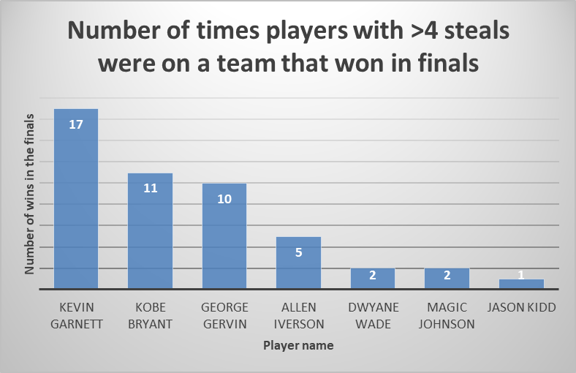

Slide 30
Q8: conclusions
Out of all the players who have over 4 known steals, Kevin Garnett, Kobe Bryant, and George Gervin have been on a team that won in the finals the most number of times. (17 times, 11 times, and 10 times respectively)
Meanwhile Jason Kidd was only on a team that won the finals once

Slide 31
Q9: number of people awarded in each category in the hall of fame from 1980 to 2000
SELECT "year", CATEGORY, COUNT(CATEGORY) AS NUMHOF
FROM BASKETBALL_HOF
WHERE "year">=1980 AND "year"<=2000
GROUP BY "year", CATEGORY
ORDER BY "year";

Slide 32
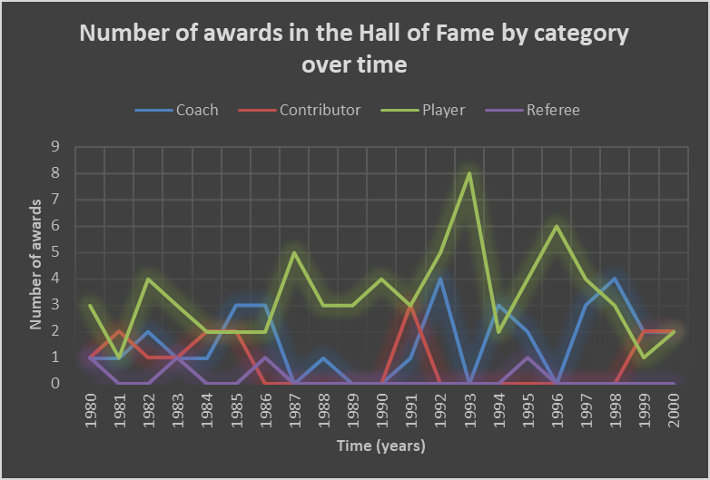

Slide 33
Q9: conclusions
People are more likely to be in the Hall of fame in the “Player” category
In 1987, 1989, 1990, 1993 and 1996, there were spikes in the “player” category and no other categories were awarded in the hall of fame
The “referee” category is the least commonly awarded throughout time

Slide 34
Q10: # times Boston Celtics has won and lost against team2 in a match in the playoffs
CREATE VIEW Team2Losers AS
SELECT S."year", S.SERIES, S.TMIDLOSER
FROM BASKETBALL_SERIES_POST S JOIN BASKETBALL_TEAMS T ON S.TMIDWINNER=T.TMID
WHERE name = 'Boston Celtics' AND TMIDLOSER IS NOT NULL
GROUP BY S."year", S.SERIES, S.TMIDLOSER;
CREATE VIEW Team2Winners AS
SELECT S."year", S.SERIES, S.TMIDWINNER
FROM BASKETBALL_SERIES_POST S JOIN BASKETBALL_TEAMS T ON S.TMIDLOSER=T.TMID
WHERE name = 'Boston Celtics' AND TMIDWINNER IS NOT NULL
GROUP BY S."year", S.SERIES, S.TMIDWINNER;
SELECT *
FROM
(SELECT TMIDLOSER AS team2, COUNT(TMIDLOSER) AS BCWins
FROM Team2Losers
GROUP BY TMIDLOSER) X
FULL OUTER JOIN
(SELECT TMIDWINNER AS team2, COUNT(TMIDWINNER) AS BCLoses
FROM Team2Winners
GROUP BY TMIDWINNER) Y USING(team2);
DROP VIEW Team2Winners;
DROP VIEW Team2Losers;

Slide 35
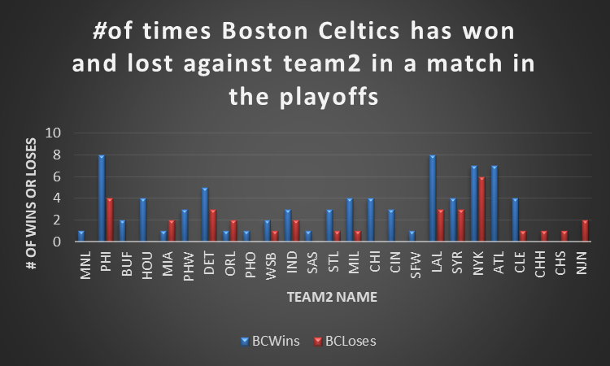

Slide 36
Q10: conclusions
The Boston Celtics (BC) have won most often against PHI and LAL. (both teams are tied at losing to BC 8 times)
The Boston Celtics have lost most often to NYK (6 times)
in general, the Boston Celtics tend to win against their opponents more often than they lose

Slide 37
Q11: The coaches that have coached more than 15 teams
SELECT (firstname || ' '|| lastname) AS fullname, numTeamsCoached
FROM
(SELECT COACHID, COUNT(TMID) AS numTeamsCoached
FROM BASKETBALL_COACHES
GROUP BY COACHID
HAVING COUNT(TMID)>15) X
JOIN BASKETBALL_MASTER M ON X.COACHID=M.BIOID
ORDER BY numTeamsCoached DESC;

Slide 38
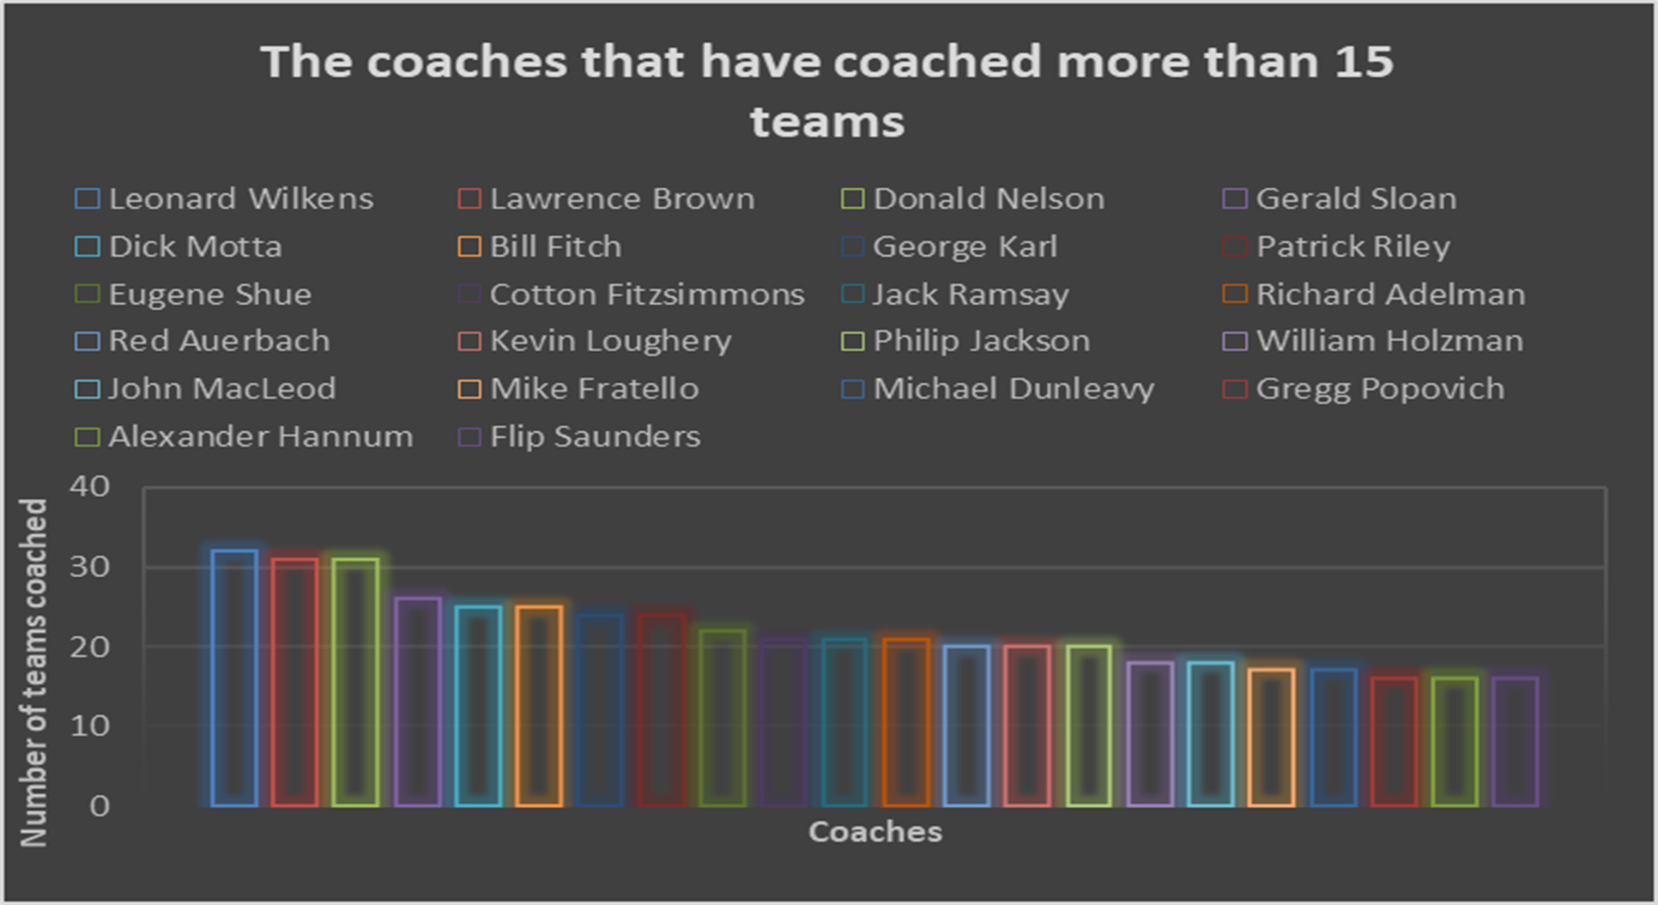

Slide 39
Q11: conclusions
Many coaches have coached over 15 teams
The top three are: Leonard Wilkens, Lawrence Brown, and Donald Nelson with 32, 31, and 31 teams coached respectively

Slide 40
Q12: Average height and weight related to max points
CREATE VIEW MaxPoints40 AS
SELECT AVG(height) AS avgH, AVG(weight) AS avgW
FROM
(SELECT PLAYER_ID, MAX(POINTS) AS MAXPOINTS
FROM BASKETBALL_PLAYER_ALLSTAR
GROUP BY PLAYER_ID
HAVING MAX(POINTS)>30 AND MAX(POINTS)<=40) X
JOIN BASKETBALL_MASTER M ON X.PLAYER_ID=M.BIOID;
CREATE VIEW MaxPoints30 AS
SELECT AVG(height) AS avgH, AVG(weight) AS avgW
FROM
(SELECT PLAYER_ID, MAX(POINTS) AS MAXPOINTS
FROM BASKETBALL_PLAYER_ALLSTAR
GROUP BY PLAYER_ID
HAVING MAX(POINTS)>20 AND MAX(POINTS)<=30) X
JOIN BASKETBALL_MASTER M ON X.PLAYER_ID=M.BIOID;
CREATE VIEW MaxPoints20 AS
SELECT AVG(height) AS avgH, AVG(weight) AS avgW
FROM
(SELECT PLAYER_ID, MAX(POINTS) AS MAXPOINTS
FROM BASKETBALL_PLAYER_ALLSTAR
GROUP BY PLAYER_ID
HAVING MAX(POINTS)>10 AND MAX(POINTS)<=20) X
JOIN BASKETBALL_MASTER M ON X.PLAYER_ID=M.BIOID;
CREATE VIEW MaxPoints10 AS
SELECT AVG(height) AS avgH, AVG(weight) AS avgW
FROM
(SELECT PLAYER_ID, MAX(POINTS) AS MAXPOINTS
FROM BASKETBALL_PLAYER_ALLSTAR
GROUP BY PLAYER_ID
HAVING MAX(POINTS)>0 AND MAX(POINTS)<=10) X
JOIN BASKETBALL_MASTER M ON X.PLAYER_ID=M.BIOID;
SELECT X.avgH AS to10avgH, X.avgW AS to10avgW, Y.avgH AS to20avgH, Y.avgW AS to20avgW, Z.avgH AS to30avgH, Z.avgW AS to30avgW, ZZ.avgH AS to40avgH, ZZ.avgW AS to40avgW
FROM MaxPoints10 X, MaxPoints20 Y, MaxPoints30 Z, MaxPoints40 ZZ;
DROP VIEW MaxPoints10;
DROP VIEW MaxPoints20;
DROP VIEW MaxPoints30;
DROP VIEW MaxPoints40;

Slide 41
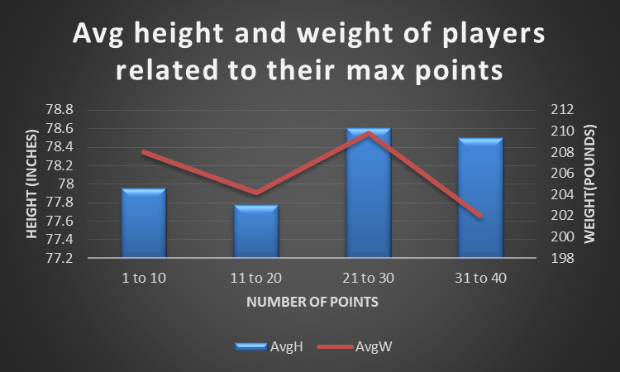

Slide 42
Q12: conclusions
The players were grouped into categories based on the max number of points they ever got in a single game
Players whose max number of points ranged from 21-30 points tended be taller and heavier than other players
Interestingly, players with 31-40 points tended to be quite tall but were also the lightest group
Players with 1-10 points or 11-20 points tended to be shorter

Slide 43
Q13: wins by the top 5 teams in finals out of the total wins in the finals
CREATE VIEW teamNumWins AS
SELECT TMIDWINNER, COUNT(TMIDWINNER) AS numWins
FROM BASKETBALL_SERIES_POST
WHERE round='F'
GROUP BY TMIDWINNER
ORDER BY numWins DESC;
SELECT *
FROM
(SELECT SUM(numWins) AS totalWins
FROM teamNumWins)
NATURAL JOIN
(SELECT SUM(numWins) AS totalWinsTop5
FROM
(SELECT *
FROM teamNumWins
WHERE rownum <= 5));
DROP VIEW teamNumWins;

Slide 44
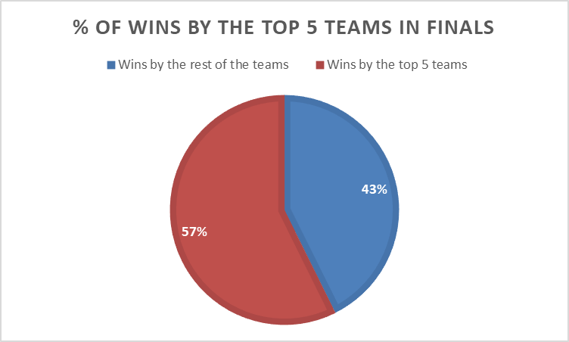

Slide 45
Q13: conclusions
The top 5 teams in the finals were defined by the teams who won the finals the most number of times
The top 5 teams accounted for over half of the total number of wins in the finals at 57%.
The rest of the teams all together only accounted for 43% of the total wins

Slide 46
Q14: # players who played for only one team vs 2-5 teams vs more than 5 teams
CREATE VIEW numTeamsOver5 AS
SELECT COUNT(*) AS overFiveTeams
FROM
(SELECT PLAYERID, COUNT(DISTINCT TMID)
FROM BASKETBALL_PLAYERS
GROUP BY PLAYERID
HAVING COUNT(DISTINCT TMID)>5);
CREATE VIEW numTeams2to5 AS
SELECT COUNT(*) AS twotofiveTeams
FROM
(SELECT PLAYERID, COUNT(DISTINCT TMID)
FROM BASKETBALL_PLAYERS
GROUP BY PLAYERID
HAVING COUNT(DISTINCT TMID)>1 AND COUNT(DISTINCT TMID)<=5);
CREATE VIEW numTeams1 AS
SELECT COUNT(DISTINCT PLAYERID) AS oneTeam
FROM BASKETBALL_PLAYERS P
WHERE NOT EXISTS(
SELECT *
FROM BASKETBALL_PLAYERS
WHERE PLAYERID=P.PLAYERID AND TMID<>P.TMID);
SELECT *
FROM numTeams1, numTeams2to5, numTeamsOver5;
DROP VIEW numTeams1;
DROP VIEW numTeams2to5;
DROP VIEW numTeamsOver5;

Slide 47
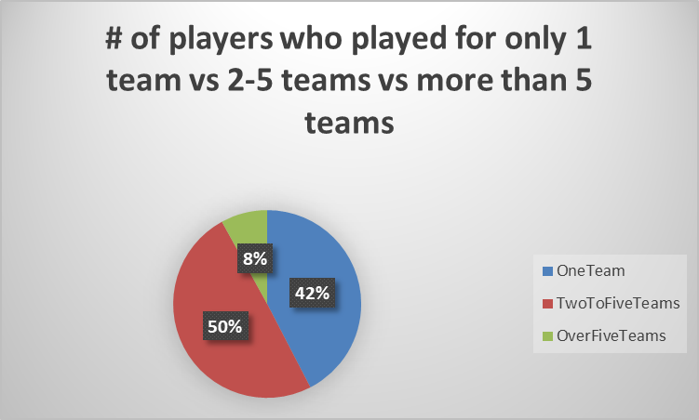

Slide 48
Q14: conclusions
Most players only play for 1 team (42%)
However, players who’ve played for 2 teams, 3 teams, 4 teams, and 5 teams added up account for 50% of all the players
Players who have been on over 5 teams account for only 8% of the total

Slide 49
Q15: AVG win to lose ratio of ABA teams vs NBA teams between 1967 to 1976
SELECT "year", LGID, avg(won/lost) AS avgwinloseratio
FROM BASKETBALL_TEAMS
WHERE "year" >=1967 AND "year" <1976
GROUP BY "year", LGID
ORDER BY "year", LGID;

Slide 50
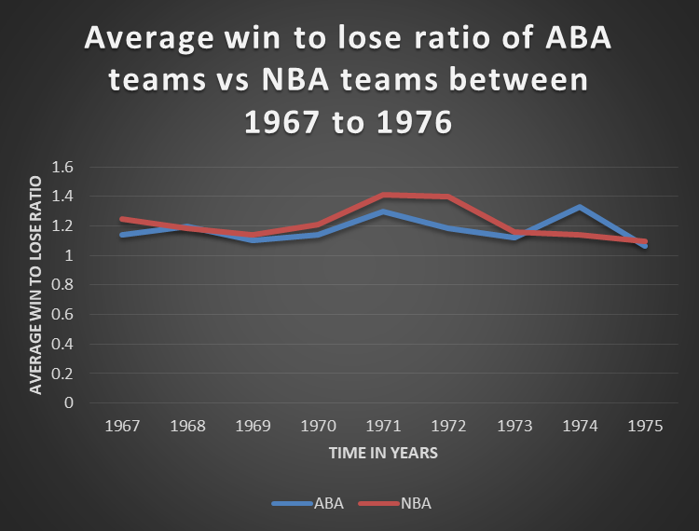

Slide 51
Q15: conclusions
The average win to lose ratio tended to be higher in the NBA than the aba, although not by very much
The ABA win to lose ratio spiked in 1974, but then decreased again in 1975

Slide 52


